Slide 1
Math Talks for the Younger Set
Gwen Neu
TK-8th Grade Teacher
Maple Creek Elementary School

Slide 2
From the leader – Jo Boaler
https://www.youtube.com/watch?v=YKegyzRj8-k
1 minute 37 sec of the clip

Slide 3
What is a Math Talk?
Whole group math activity – typically mental math (the hard core insist it be only mental)
Lasts 5 – 10 minutes for this age group
An opportunity for students to share their math thoughts
Students justify their answers
Students politely critique others
Students see alternative ways to think about a problem

Slide 4
When and Why?
To move from reliance on memorization to true understanding of math concepts
Help students recognize and use structure to understand the complexity of math concepts
Use as a regular routine with talks that build on each other
Activates prior knowledge
Develop a stronger sense of math identity and confidence
Treat mistakes as learning opportunities that contribute to everyone’s understanding of the task

Slide 5
What can students learn?
Flexibility, accuracy, and efficiency in math thinking
Ways to make sense of math tasks and strategies to complete them
Ease with composing and decomosing numbers
Conceptual understanding of the relationships between numbers
Math reasoning skills
Multiple strategies to solve a problem
Multiple representations of the solution to a problem
Confidence
Empowerment

Slide 6
Defining Features
Facilitation Feature | Student Experience
Problems are written and read publicly; students solve mentally (as much as possible) | Students develop efficiency, accuracy, and fluency Students move away from algorithms and memorization toward sense-making
Wait Time | All students have time to reflect and struggle
Silent Signals Silent Validations | Students learn to come up with at least one idea
Include Mistakes | Students learn to see mistakes as learning opportunities
Teacher scribes AFTER student explains Teacher confirms proper representation | Scribing reflects student’s actual process
Engage students in discussion | Students make sense of other strategies
Adapted From: OUSDMathInstructionalToolkit2013-2014
http://blog.mrmeyer.com/wp-content/uploads/OUSDMathInstructionalToolkit2013-14.pdf

Slide 7
Engagement Questions
Who did it exactly the same way as ____?
Can you do that?
What happened?
Did everyone understand ________’s way?
Can you explain _____’s strategy in your own words?
Who has another way of solving it?

Slide 8
Sentence/Question Stems for discussions:
I agree/disagree with ____ because ____.
How did you decide to ______?
These ways are alike/different because _____.
The strategy I used was _____.
I don’t understand your solution/strategy. Can you please explain it again?
Can we both be right? How?
Where did ______ go wrong?

Slide 9
Procedural Steps (requires modeling at first)
Create/Review an Anchor Chart for Group Norms
Present a problem/task
Give students time to think (time varies with task, typically five minutes)
Have students use silent signals to let you know they are ready
Call on one student at a time; listen to strategy and then scribe the strategy for all to see; validate your representation
Ask engagement questions as appropriate to the situation
Force it – allow for awkward silence because it’s important
Encourage students to talk to each other without you in the middle

Slide 10
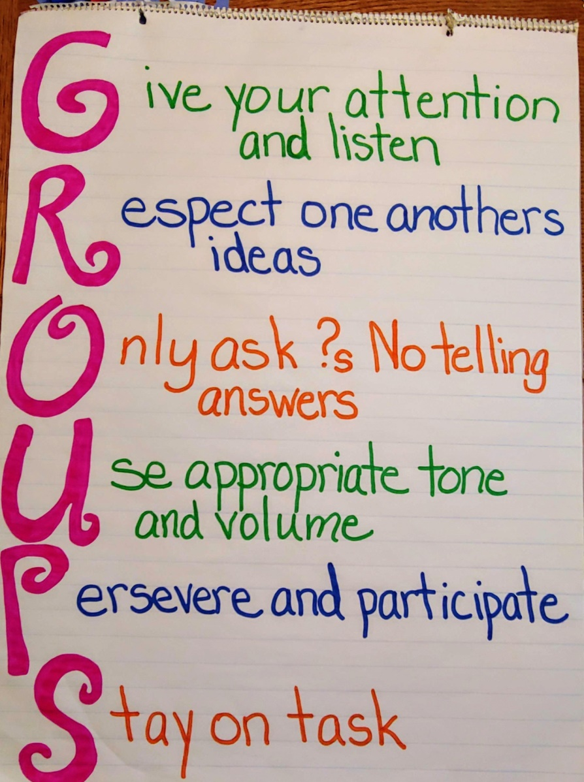
Sample Anchor Chart
https://mnmmath.wordpress.com/2018/10/07/are-you-ready-for-more/

Slide 11
Math Talk in Action
https://www.youtube.com/watch?v=62epCIFdRa0
From Math Solutions, a K-1st Math Talk (5 min., 31 sec.)

Slide 12
Math Tasks
As we work through the tasks; think and talk about:
The math involved
How you can use (or have used) it in your classroom
Potential obstacles and ways to overcome them
Dot Cards
Geometric Subitzing
Represent It
Target Number
Make It True
Exploding Dots

Slide 13
Dot Cards (Steve Wyborney’s site is AWESOME https://www.stevewyborney.com/)
How many dots do you see?
How do you know?
Let’s try it with one ofSteve Wyborney’s PP set.

Slide 14
Geometric Subitizing https://gfletchy.com/2016/10/10/geometric-subitizing-a-different-kind-of-number-talk/
How many shapes did you see?
How many sides did you see?
Subitizing: the ability to 'see' a portion of a set of objects and know how many there are without counting.

Slide 15
Represent It
In what ways can you represent this number?
15

Slide 16
Target Number
Using the numbers below, how can you hit the target?
20
0 1 2 3 4 5 10 21

Slide 17
Make It True
5 + 3 = 6 + 4

Slide 18
Exploding Dots: The Global Math Project https://www.explodingdots.org/g/wicked-fireant-28
Begin on the right. Add one dot at a time. Each place can contain only one dot. Each time you add a dot, the two explode into one and lands on the place to the left.
1 2
Develop a code for each number beginning with 0:
0 = 0
1 = 1
2 = 20
3 =
What will be the code for 15? For 18?

Slide 19
Math Tasks Resources
Dot Cards:
https://www.youcubed.org/resources/jo-teaching-visual-dot-card-number-talk/,
http://www.santeesd.net/cms/lib/CA01000468/Centricity/domain/19/ccuploads/KinderRoutines02112013.pdf
https://www.stevewyborney.com/
Geometric Subitzing: https://gfletchy.com/2016/10/10/geometric-subitizing-a-different-kind-of-number-talk/
Represent It: use any number, maybe the number of the day
Target Number: use any target number and set of digits to encourage flexibility with computation
Make It True: Use equations from the math text
Exploding Dots: https://www.explodingdots.org/g/wicked-fireant-28

Slide 20
Book Resources
Boaler, Jo: Mathematical Mindsets, Mindset Mathematics
Hughes, Nancy: Classroom Ready Number Talks for Kindergarten, First, and Second Grade Teachers
Parrish, Sherry: Number Talks: Whole Number Computation, Grades K-5

Slide 21
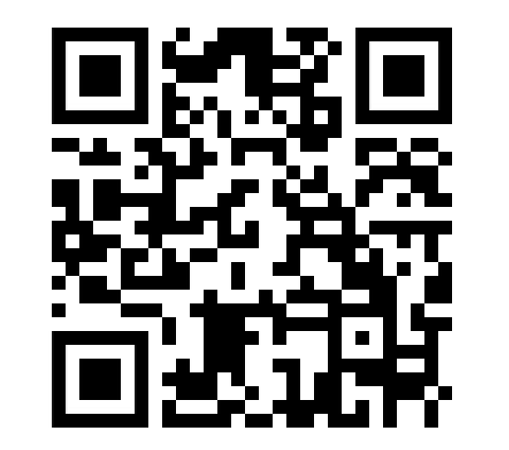
Please take a minute to complete the session evaluation.The link below is also on the CMCFN website.
https://sites.google.com/site/cmcfnconfeval/

